Slide 1
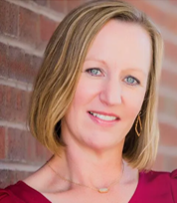
Colorado Bad Faith Update
Katherine Kust, Partner
Gordon Rees Scully Mansukhani
Rebecca Wagner, Partner
Campbell Wagner and Frazier, LLC
Sandy Eloranto, Shareholder
Sutton |Booker

Slide 2
UM/UIM Updates
Fear v Geico
Summary of case and opinion
How it is playing out: waiver of privilege for post litigation claim notes and files

Slide 3
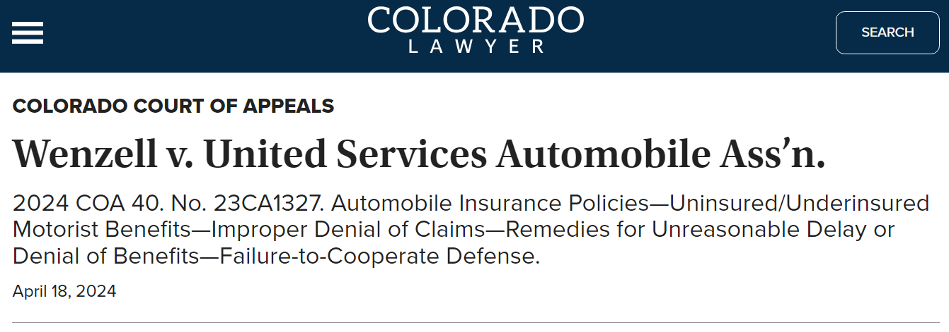
UM/UIM Updates
Wenzell v USAA and 10-3-1118
Summary of case and opinion
How it is playing out: condition precedent defenses

Slide 4
UM/UIM Updates
CRS 10-3-1117 enforcement
Classic Car UM/UIM limits
Other Bad Faith Set Up Trends

Slide 5
Property Updates
Delayed Notice Prejudice Rule applied to property claims
Gregory v Safeco; Runkel v Owners, 2024 CO 13, 22SC399 & 22SC563 – notice prejudice rule applies to residential property policies
DSB LLC v SF, 22-cv-01722-RM-SBP (Colo. July 24, 2024) Moore holding storms between DOL and FNOL = prejudice
Enforcement of 12 months to repair
Enforcement of time to sue us

Slide 6
Property Updates
Contractors with Assignments
Review contract language and what specifically was assigned
Challenge standing if contractor has done no repairs. DSB LLC v SF, 22-cv-01722-RM-SBP (Colo. July 24, 2024)
Review policy language on assignment but haven’t seen a court enforce prohibition without consent yet

Slide 7
Property Updates
Wildfire Litigation and Lessons Learned
Significant storms in 2023
May 10, 2023 (up to 1.75 inch hail, Centennial / Aurora)
June 22, 2023 (Tornado, Littleton)
DOI Updates

Slide 8
Appraisal Updates
Bonbeck Parker – 14 F.4th 1169
“Amount of Loss”
Causation vs coverage
Change in law per Brimmer (2021 WL 5579052)
Code upgrades = coverage
Consequence of not paying award
Not breach – Thornton v. Owners (Moore, 2023 WL 8018257)
Could be breach - Bertisen v Travelers (Wang, 2023 WL 5822504)
Consider filing a counterclaim dec action to set aside/vacate award or separate motion with answer (see Bertisen)
Award higher than what was paid before does not equal breach (2021 WL 5957418)

Slide 9
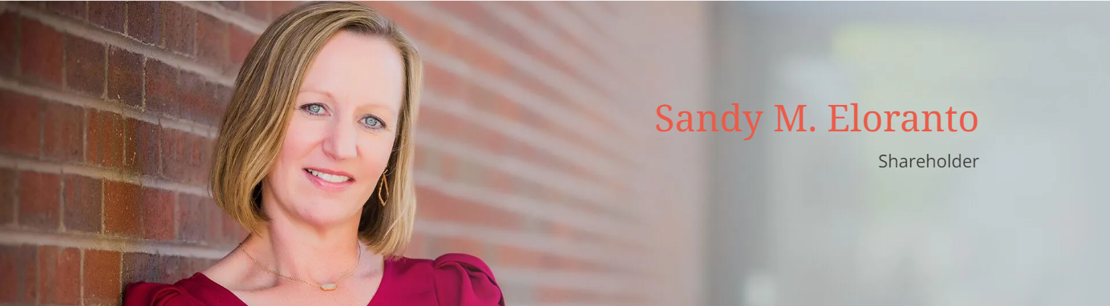
rwagner@wsf-law.net

